Slide 1
Salivary gland pathology
Dr G Mahendra
Dept of Pathology

Slide 2
Salivary gland pathology
At the end of this lecture the student should be able to
Recapitulate the normal anatomy and physiology of salivary glands
Describe the pathology of acute sialadenitis
Describe the aetiology , pathogenesis and pathology of chronic sialadenitis
List the common types of benign and malignant tumours of salivary glands and briefly describe the pathology of few of the common neoplasms

Slide 3
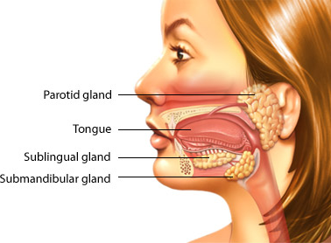
Salivary glands
Major salivary glands
Parotid
Submandibular sublingual
Minor salivary glands
Numerous
Intra-oral

Slide 4
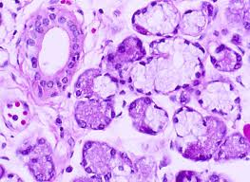
Salivary gland histology
Compound exocrine glands with ductal and acinar portions
Acinar portion is serous, mucinous or mixed
Acini are lined by luminal cells, which are enclosed by myoepithelial cells

Slide 5
Salivary gland pathology
Inflammation
Autoimmune conditions
Neoplasms

Slide 6
Inflammation- Sialadenitis
Acute sialadenitis
mumps
Commonest acute inflammatory lesion
Usually bilateral parotid glands
Sub mandibular gland –rarely
Sheds the virus in saliva
Complicated with pancreatitis and orchitis
Suppurative
Caused by pyogenic cocci
Complication of post operative dehydration
Elderly immunocompromized

Slide 7
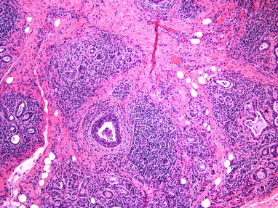
Sialadenitis
Chronic sialadenitis
Associated with calculi
Parotids and submandibular glands
Acinar atrophy, inflammation and interstitial fibrosis

Slide 8
Autoimmune
Sjögren syndrome
Generalized exocrinopathy
Salivary and lacrimal glands
Dry mouth and dry eyes
Can be associated with other autoimmune diseases like rheumatoid arthritis
Acinar loss and extensive lymphocytic infiltration of gland
Long term- risk of lymphoma in parotid gland

Slide 9
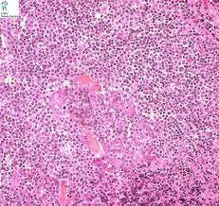
Sjögren syndrome
Acinar loss and extensive lymphocytic infiltration of gland

Slide 10
Tumours of salivary glands
Uncommon
80% occurs in parotid gland
85% are benign
There are many types of tumours
17 types of benign tumours
22 types of malignant tumours
Higher relative incidence of malignancy in minor salivary glands

Slide 11
Salivary gland tumours
Most of the salivary gland tumours arises from
Ductal lining epithelium
Underlying myoepithelial layer
Few arise from acini

Slide 12
Benign salivary gland tumours-adenomas
Broadly classified into
Pleomorphic adenoma
Monomorphic adenoma
Pleomorphic adenoma
Commonest tumor of salivary glands
Commonest site is parotid gland

Slide 13
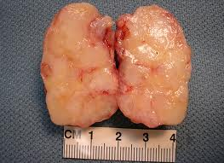
Pleomorphic adenoma
Macroscopy
Circumscribed
Smooth or nodular surface
Cut surface
Grayish –white and bluish
Solid and cystic
Glistening
Soft and mucoid

Slide 14
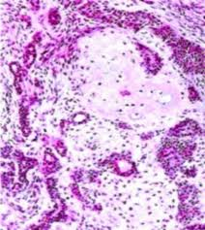
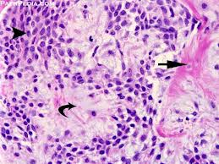
Pleomorphic adenoma -microscopy
“Pleomorphic”- mixed appearance
Epithelial elements-ducts, acini, sheets or strands
Myoepithelial elements –spindle/polygonal cells
Mesenchymal elements
mucoid, myxoid and chondroid stroma

Slide 15
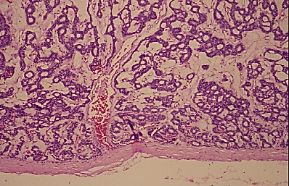
Monomorphic adenoma
Benign salivary gland tumours of epithelial origin without a mesenchymal component.
Various forms
basal cell, canalicular, sebaceous, glycogen-rich and clear cell
basal cell adenoma is the most common
majority of monomorphic adenomas display nonaggressive behavior and are adequately treated with surgical excision

Slide 16
Malignant salivary gland tumours
Mucoepidermoid carcinoma
Malignant mixed tumour
Adenoid cystic carcinoma
Acinic cell carcinoma
ductal adenocarcinoma
Undifferentiated carcinoma

Slide 17
Mucoepidermoid carcinoma
Most common malignant salivary gland tumour
Parotid gland and minor salivary glands of palate
Could be induced by radiation
Composed of
Mucin producing cells
Squamous cells
Intermediate cells
Clear cells
Depending on differentiation
Low-intermediate –high grade tumours

Slide 18
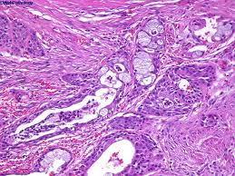
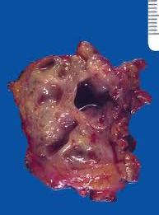
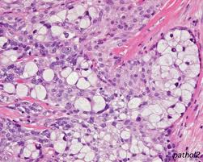
Muco epidermoid carcinoma

Slide 19
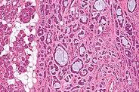
Adenoid cystic carcinoma
Second most common salivary gland malignancy
Most common in the submandibular, sublingual and minor salivary glands
Demonstrate perineural invasion- presents with pain

Slide 20
Malignant mixed tumour
Occur in 3 forms
Carcinoma ex-pleomorphic adenoma
carcinoma develops from the epithelial component of a preexisting pleomorphic adenoma.
Carcinosarcoma
metastatic lesions contain both the stromal and epithelial elements.
metastasizing mixed tumor
otherwise benign acting pleomorphic adenoma that develops metastatic deposits of tumor.

Slide 21
Premalignant and malignant oral lesions

Slide 22
Precursor lesions
Most oral cancers develop from precancerous or potentially malignant lesions in the tissue lining the inside of the mouth.
“epithelial dysplasia.”
Overall, less than 10 percent of patients advance to cancer from a precancerous lesion.
The risk is high for high grade dysplasia
All patients with a history of precancerous lesions need to be followed closely

Slide 23
Clinical presentations of precancerous lesions
Leukoplakia
white patches with unexplainable cause.
the most common precancers
carry the smallest chance of developing into cancer.
What are the causes for a white patch in oral cavity?

Slide 24
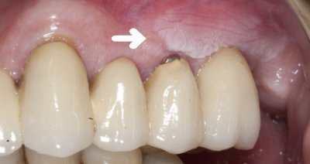
Leukoplakia

Slide 25
Clinical presentations of precancerous lesions
Erythroplakia
unexplained reddish patches.
rarer than white patches,
lesions with a red component have the highest potential for becoming malignant.

Slide 26
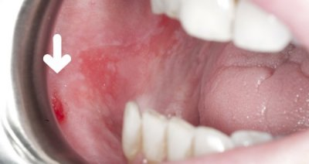
Erythroplakia

Slide 27
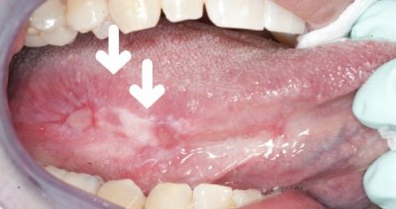
Clinical presentations of precancerous
lesions
Erythroleukoplakia
Red and white patches can appear combined.

Slide 28
Oral precancers
Usually asymptomatic and painless
Early detection of precancerous lesions is critical to preventing a malignant transformation.
Genetic studies could determine
risk for progression of precancer to cancer
risk of metastasis
tumor recurrence
additional primary tumors.

Slide 29
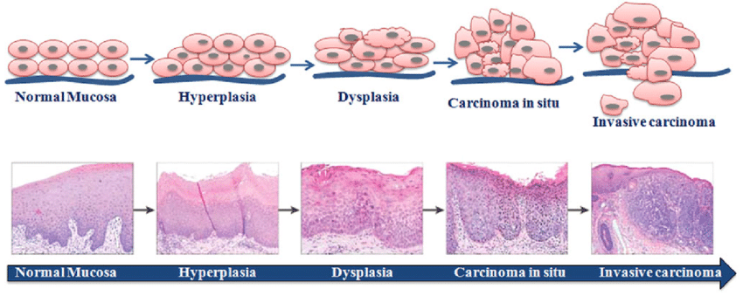
Oral cancer progression

Slide 30
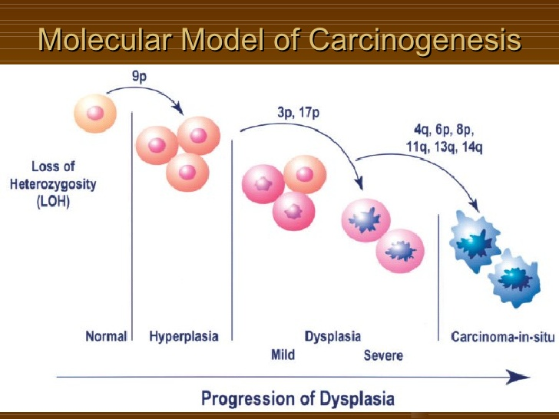

Slide 31
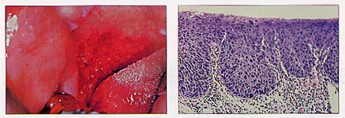
Carcinoma in situ

Slide 32
Pathogenesis of SCC of oropharynx
Chewing of betel quid is the major cause in Asian region- areca nuts, lime and tobacco
Tobacco
Alcohol
Chronic irritation
Poor oral hygine
Human papilloma virus(HPV) associated

Slide 33
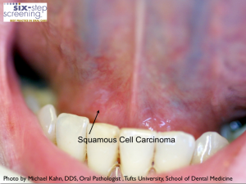
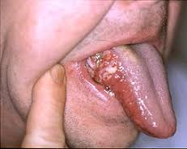
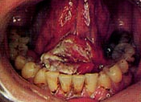
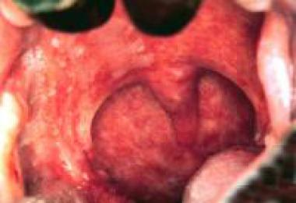
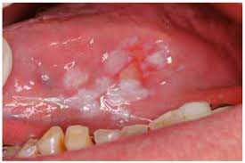
Squamous cell carcinoma of oropharynx

Slide 34
Squamous cell carcinoma
Desmosomal bridges between cells.
Abundant organophilic (keratinized) cytoplasm,
Extracellular squamous pearls, ("keratin pearl").
Nuclear anaplasia., hyperchromatism.
Frequent abnormal mitosis

Slide 35
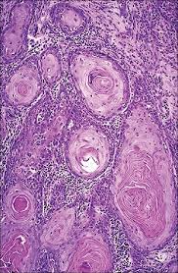
Squamous cell carcinoma
Most cells are easily identifiable as squamous cells.
There is a mass of parakeratin ("keratin pearl").

Slide 36
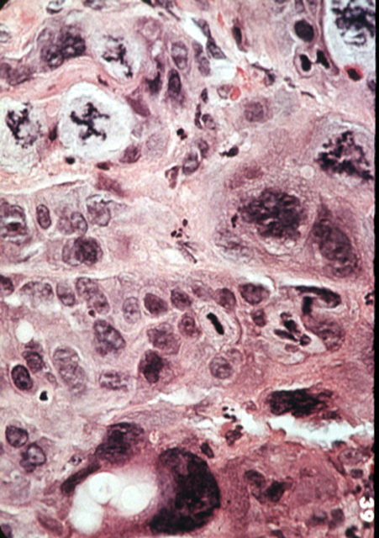
Squamous cell carcinoma
Marked hyperchromasia of the nuclei
Atypical mitoses

